Slide 1
Implementing ACEs & Social Determinants of Health (SDoH) Into Your Practice to Improve Care for Children, Youth and Families
Facilitator: Dr. Shirley Sze
Presenters/Panelists: Dr. Christine Loock, Ethan Ponton, Alesia DiCicco, Taylor Ricci, Dr. Eva Moore, Dr. Matt Carwana, Dr. Will Lau
Dec 17, 2020
Doctors of BC CYMHSU CoP Webinar

Slide 2
We would like to acknowledge that we live, work, play and grow on the unceded, ancestral territories of the Coast Salish Peoples: xʷməθkʷəy̓əm (Musqueam), sḵwx̱wú7mesh (Squamish) and sel̓íl̓witulh (Tsleil-Waututh)

Slide 3
Objectives
Goals and Objectives
Examine how the SDoH BEARS project was designed to improve experience of care for the children, youth and families.
Recognize the importance and feasibility of using a SDoH screening tool, such as the BEARS questionnaire, in clinical practice.
Evaluate the importance of implementing ACEs and SDoH screening and supports into practice and determine how to do it through available resources.
Determine ways to influence health authorities and Ministries to integrate supports for social determinants of health into team-based care.
OPSEI Surgery and Society site
https://www.bcchr.ca/opsei/surgery-and-society
https://www.cps.ca/en/documents/position/what-paediatricians-can-do-to-support-children-and-youth-during-the-covid-19

Slide 4
Substantive Equity
Substantive equality
refers to the requirement to achieve equality in opportunities and outcomes, and is advanced through equal access, equal opportunity and, the provision of services and benefits in a manner and according to standards that meet any unique needs and circumstances, such as cultural, social, economic and historical disadvantage.
https://engage.gov.bc.ca/app/uploads/sites/613/2020/11/In-Plain-Sight-Full-Report.pdf
Kwulasultun, Coast Salish Artist
Spindlewhorl: Movement & Creation

Slide 5
SDOH/BEARS Team
Principal Investigators:
Dr. Christine A. Loock
Dr. Douglas Courtemanche
Collaborators
Dr. Andrew MacNeily
UBC co-op students:
Haley Eng
Mathilda Silk
Tongtong Zhai
Cyrus Biladvala
Tisha Dasgupta
Beenu Bajwa
Co-Investigators
Mr. Damian Duffy
Dr. Jane Gardiner
Dr. Robert Baird
Ms. Rebecca Courtemanche
Dr. Matthew Carwana
Dr. Eva Moore
Dr. Tanjot Singh
Mr. Ethan Ponton
Ms. Bonnie He
Mr. Will Lau
Ms. Alesia Dicicco
Ms. Taylor Ricci
Ms. Amy Beevor-Potts
Ms. Melody Tsai
Ms. Lisa Szostek
THANK YOU!
BCCH Social Work
UBC Faculty of Medicine
Department of Pediatrics
Department of Surgery
MASES Engagement Fund
RICHER team + Community partners
BC Children’s Youth Advisory Council
BC Women’s Indigenous Health
UBC CUES Fund

Slide 8
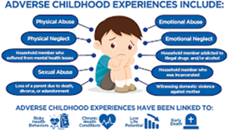
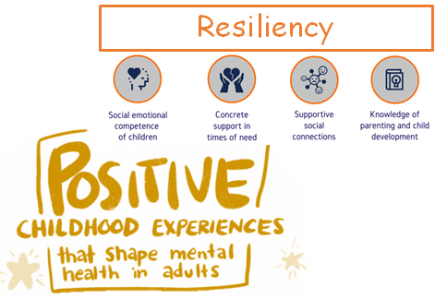
The SDoH BEARS Project
SDoH Survey n=693
OPSEI led by Damian Duffy laid the groundwork for Surgery & Society to join forces. The Doctors of BC embarked on ACEs as part of the CYMHSU Partnership.
In 2017, there was limited BC data on SDoH or ACEs for pediatric/adolescent aged ambulatory patients.
BEARS n= 159
Barriers
Economic Status (SES)
Adversity
Resiliency
Social Capital + PCEs (BEARS-Y)
Optional ACEs

Slide 9
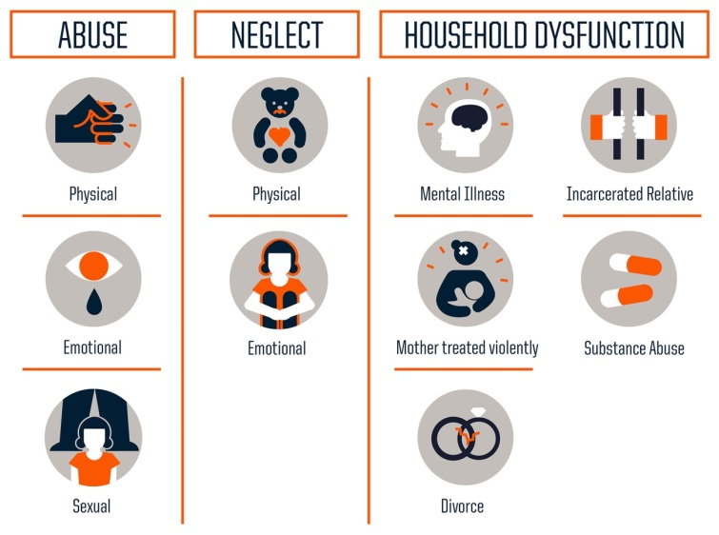
Surgery and Society
30 SDoH Questions + Optional ACEs
Participants: Convenience sample of families/caregivers at BCCH Goal 15/clinic: n ~ 150 Expanded in 2018 to include multidisciplinary teams with SW: MDT (N=693)
10 Ambulatory Surgical Clinics | 3 MDT Clinics
Cerebral Palsy [Ortho] Dentistry ENT General Surgery Neurosurgery Ophthalmology Ophthalmology [RICHER] Orthopedics Plastics Urology | Cleft Palate Craniofacial VIP (Vision) Spinal Cord
OPSEI Surgery and Society site
https://www.bcchr.ca/opsei/surgery-and-society
Notes:
Original goal was ~ 150-….we were on a role

Slide 11
BEARS Impact & Feasibility
Alesia DiCicco & Taylor Ricci
Purpose
To evaluate the Social Determinants of Health BEARS Questionnaire that is currently in use at BC Children’s Hospital by exploring the experiences of staff who have adopted this questionnaire into their clinics.
Objectives
To determine if and how the BEARS Questionnaire changed the practice of adopting clinicians.
To determine the utility and functionality of the BEARS Questionnaire as a social history questionnaire.
Methods
Part 1. Online Survey and Interviews
Part 2. Analysis of Responses and Themes

Slide 12
THEME 1- Examining how adopting the BEARS Questionnaire changed clinician practice
Prior to implementing the BEARS Questionnaire, 29% of clinicians reported that they “sometimes” or “often” reviewed social determinants of health with their patients and families. (N=14)
After implementing the BEARS Questionnaire, 85% of clinicians reported that they “sometimes” or “often” reviewed social determinants of health with their patients and families. (N=13)
“We’ve got to understand our patients in order to provide appropriate support and the BEARS is a great way of gathering some of that information.”
– Study Participant
Notes:
Summary: Improved rapport with patients and provided opportunity for patients to share things about their social situation that they may not have shared verbally (Social Worker Interview)

Slide 13
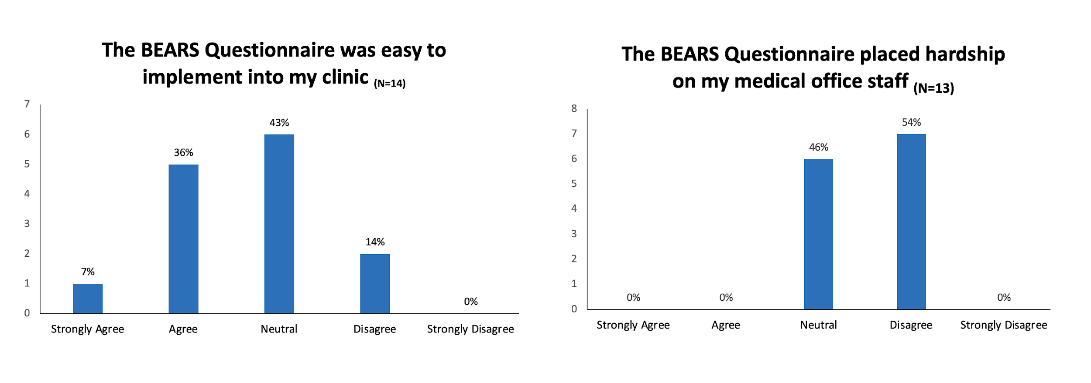
THEME 2: Feasibility of Implementing the BEARS Questionnaire into Clinic
Notes:
Summary: Most clinicians agreed that this was an easy tool to implement into their clinic and did not place hardship on their medical office staff

Slide 14
THEME 2: Feasibility of Implementing the BEARS Questionnaire into Clinic
Notes:
Summary: Overall clinicians felt that the BEARS Questionnaire did a good job at asking about social history and were more likely than not to continue using the questionnaire in their clinic

Slide 15
BEARS & ACEs
“Was asking about Adverse Childhood Experiences (ACEs) within our questionnaires perceived as being too sensitive by patients and families?”
71% (10/14) reported “Never” or “Rarely”
“What I think about the ACEs, if this is something currently happening, even if it is hard or upsetting to talk about, a lot of the time it's things we should know about. So, if it's the ACEs section of the questionnaire that brings it to light and they're willing to share, it means that on some level they are hoping to get some extra support about it.”
–Study Participant
Notes:
Part of the BEARS Questionnaire included the option for families to reflect on their child’s Adverse Childhood Experiences (ACEs). In your experience, how often did patients or families report that this was too sensitive or personal to be asked on this questionnaire?
Never (3, 21.4%), Rarely (7, 50.0%), Sometimes (3, 21.4%), Often (1, 7.1%), Always (0, 0.0%)
we recognize that our clinicians may find ACEs acceptable because these are not first time patients, they’re surgery follow up or multidisciplinary ambulatory

Slide 16
THEME 3: Supports to continue more robust social screening in our clinic visits
Clinicians reported that an online version of the BEARS Questionnaire would be useful.
BEARS is now available online through REDCap and is being implemented in virtual clinics.
“We have the tendency to ask what’s going wrong and what’s going badly and try to work from that deficits-based approach, and the resiliency piece allows us to identify what's working well and how can we utilize those strengths to empower families. I think that’s the part that I find the most inspiring.”
– Study Participant
Notes:
read out this quote

Slide 17
Early Conclusions
SDoH [BEARS] questionnaires that include ACEs can be implemented into busy clinics.
When done in the context of relationship-based care, ACEs can be asked without harm to patients and their families [non-maleficence].
Use of the BEARS Questionnaire allows clinicians to take more comprehensive social histories, and help provide care more aligned with our patients’ priorities and social context [beneficence, autonomy and justice].
Notes:
“early insights”

Slide 18
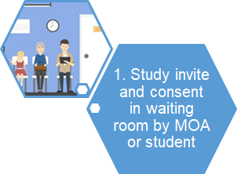
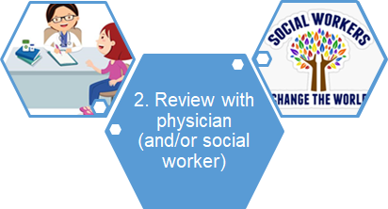
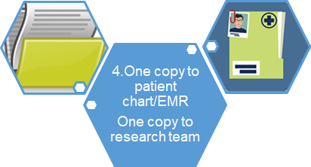
Ambulatory Clinic Workflow - Paper/Tablet
Notes:
“early insights”

Slide 19
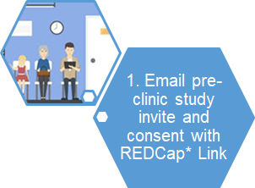
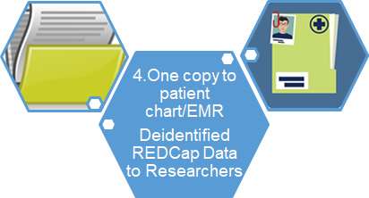
COVID Adaptations - Electronic Surveys
*REDCap & UBC Quadratics available to BC Children’s BC Women’s and UBC staff and [clinical] faculty for free.
Notes:
“early insights”

Slide 20
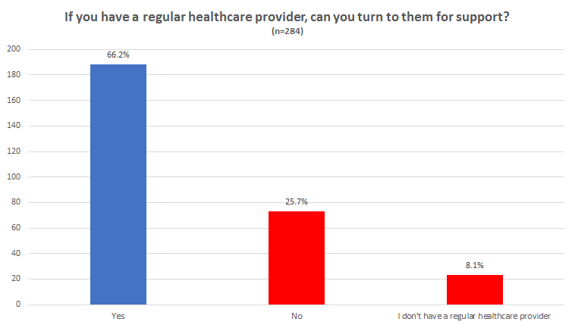
Results: Barriers to Access Supports
33.8%
1 in 3 families either don’t have a regular primary healthcare provider or do not feel that they can turn to them for support with disability forms, nutrition/calor supplements, housing, transportation forms, etc.
Notes:
Elaborate and say the whole question.

Slide 21
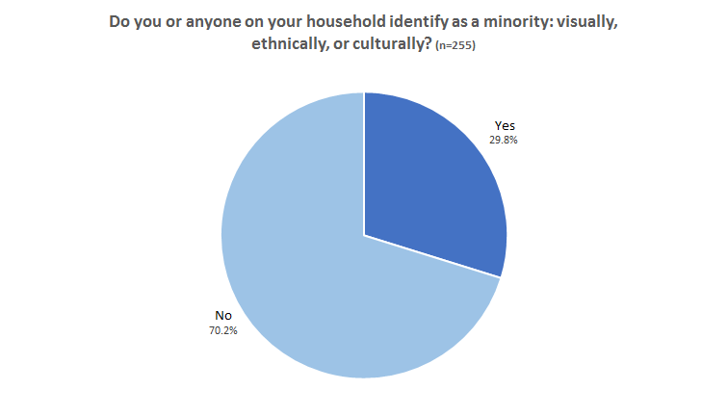
Results: Identity
1 in 3 families have at least one person in the household who identifies as a minority.
Notes:
Emphasizes the importance of being culturally competent and culturally safe. We should be asking these questions and be aware of how people identify.

Slide 22
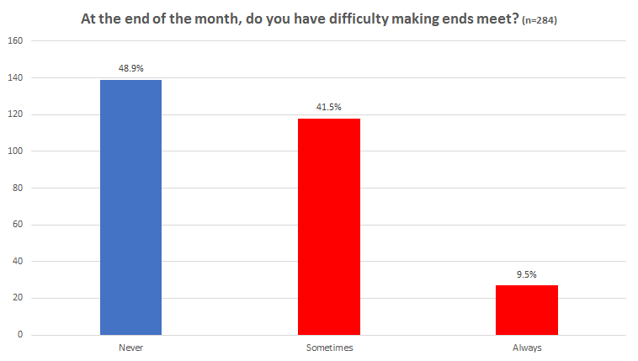
Results: Financial Hardship
51%
1 in 2 families sometimes or always have difficulty making ends meet at the end of the month.

Slide 23
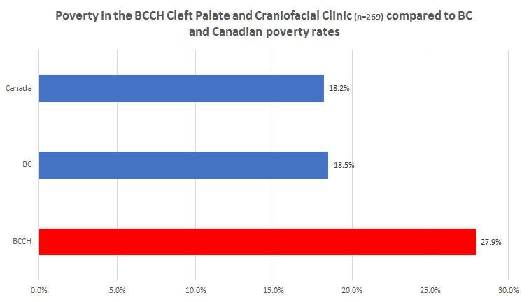
Results: Deeper Poverty
There is a higher prevalence of families living in poverty in our waiting room than the BC and Canada average.
BC and Canadian Statistics from the 2020 BC Child Poverty Report Card
Notes:
BC and Canada data taken from the 2020 BC Child Poverty Report Card

Slide 24
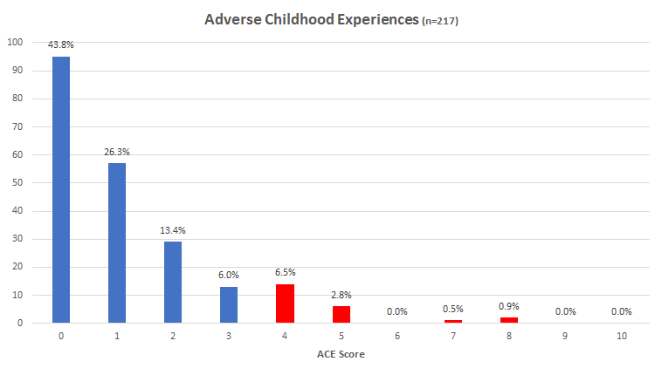
Results: ACEs
10.6%
75% of the families responded to the ACEs question.

Slide 25
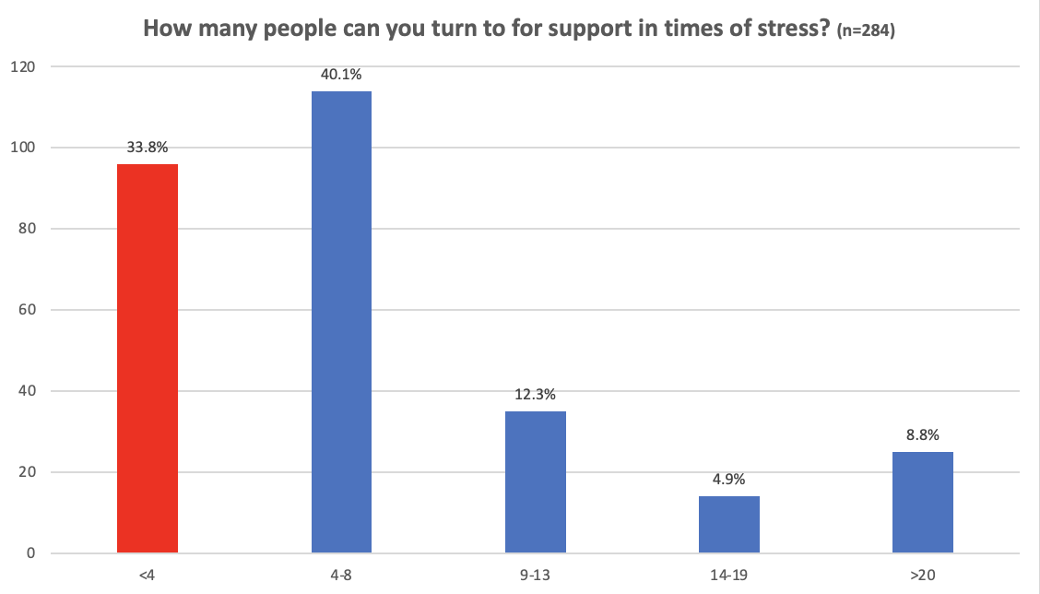
Results: Resiliency and Social Capital
1 in 3 families have fewer than 4 people that they can turn to in times of stress.

Slide 26
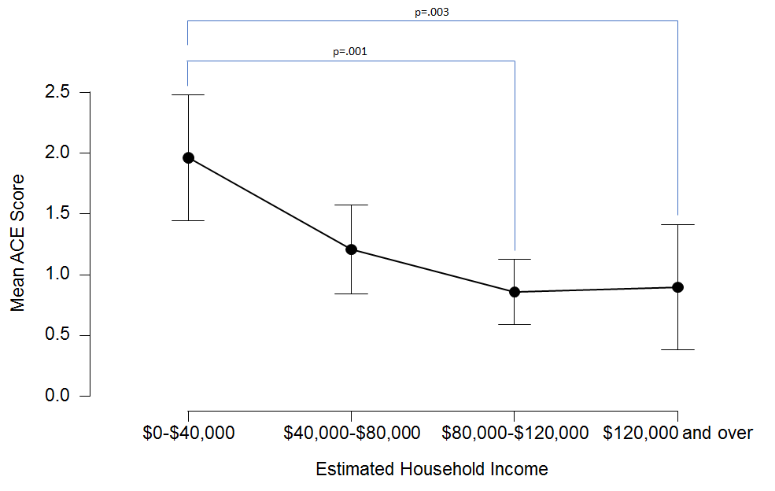
Results: ACEs and Income Gradients

Slide 27
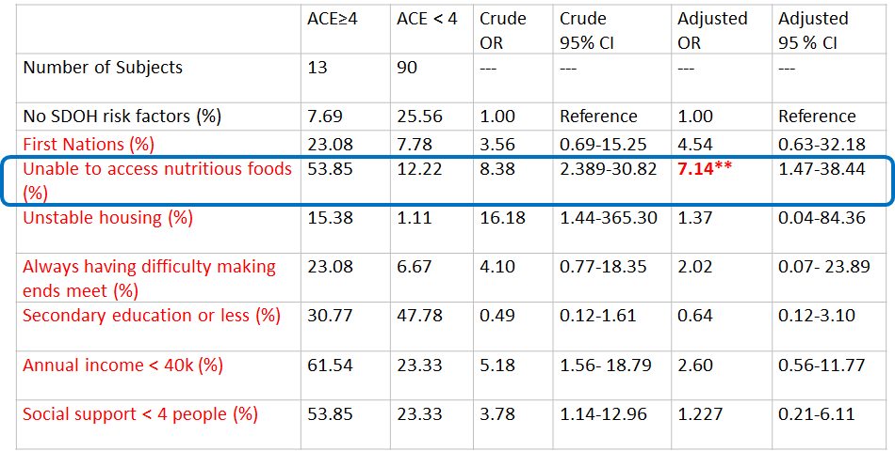
Social inequities in pediatric ophthalmology populations
Dr. Jane Gardiner & Bonnie He
Notes:
Money is a proxy to material supports.

Slide 28
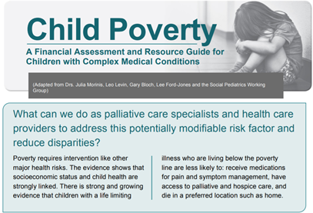
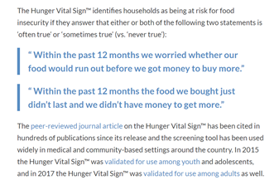
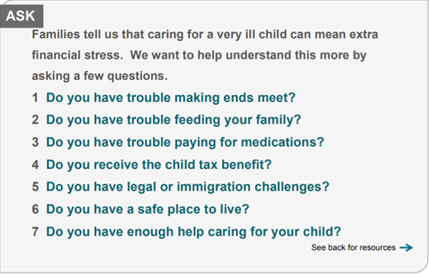
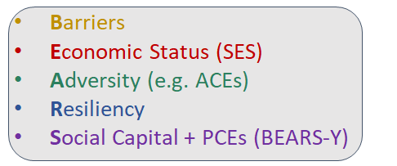
SDoH Red Flags & BEARS

Slide 29
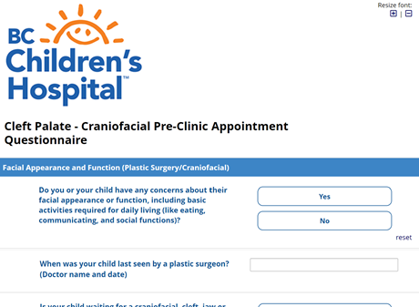
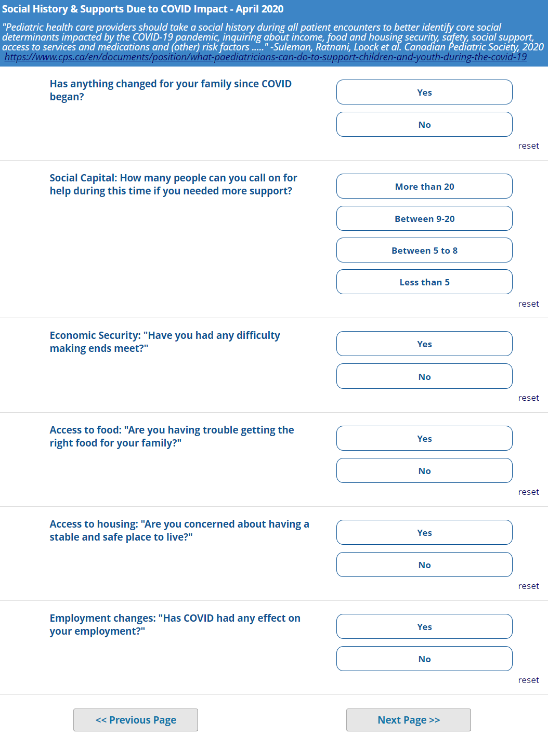
The COVID Check-in
Lisa Szostek
Purpose
The “COVID check-in” was added as part of the Cleft Palate and Craniofacial Clinic Pre-Clinic Questionnaire to ask questions pertaining to the impact that COVID-19 has had on families.
Objectives
To evaluate responses to COVID check-in questions to assess how we can improve care for families. This includes looking at health disparities, barriers to care and other social determinants of health.
https://www.cps.ca/en/documents/position/what-paediatricians-can-do-to-support-children-and-youth-during-the-covid-19

Slide 30
Food Sovereignty Study
Melody Tsai
Accessing Food Sovereignty Among Women & Children in the Downtown Eastside (DTES) During COVID-19
YWCA Crabtree Corner Community Centre & RayCam Co-operative Community Centre provide services to support women and families in the DTES
Families continue to experience food insecurity and lack of food sovereignty
Further research is required to better understand food insecurity among vulnerable families
Objectives
To evaluate responses to COVID check-in questions to assess how we can improve care for families. This may include looking at health disparities between socio-economic classes, racial groups, or other social determinants of health.

Slide 31
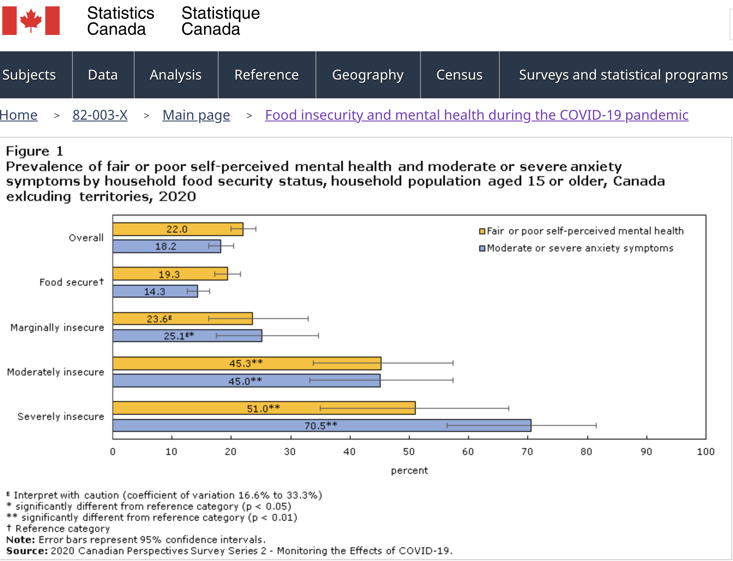
2020 Food insecurity and mental health during the COVID 19 pandemic
Younger people, females, and individuals who were divorced, widowed or separated had significantly higher odds of self-reporting either adverse mental health outcome (Table 2). Individuals who reported experiencing a major, moderate or uncertain (“too soon to tell”) financial impact because of COVID-19 had at least two times higher odds of self-reporting moderate or severe anxiety symptoms compared with those who reported no financial impact. There was no effect modification of sex or age.
https://www150.statcan.gc.ca/n1/en/pub/82-003-x/2020012/article/00001-eng.htm
Notes:
Younger people, females, and individuals who were divorced, widowed or separated had significantly higher odds of self-reporting either adverse mental health outcome (Table 2). Individuals who reported experiencing a major, moderate or uncertain (“too soon to tell”) financial impact because of COVID-19 had at least two times higher odds of self-reporting moderate or severe anxiety symptoms compared with those who reported no financial impact. For fair or poor self-perceived mental health, only an uncertain financial impact was a significant risk factor.
There was no effect modification of sex or age on the association between food insecurity and mental health outcomes (data not shown).

Slide 32
Child Rights Dialogue
Amy Beevor-Potts
Project
A community driven project exploring the experiences of youth worker staff, families, and youth in the Downtown Eastside and associated inner city neighbourhoods (DTES-IC) regarding the UN Convention of the Rights of the Child (UNCRC) and the accessibility of youth and child rights in community.
Objectives
To facilitate and empower meaningful participation and partnerships
To explore knowledge and experiences regarding UNCRC
To compare ‘child rights literacy’ among community staff, parents, and youth
To explore community priorities

Slide 33
Lessons Learned & Moving Forward
As others have shown, the proportion experiencing ACEs show a steep income gradient (Halfton et al., 2017)
Income may mask or buffer ACEs, but may not always be protective.
Ophthalmology arm of study reinforced need to ask about food security, as money is a proxy of support.
Families, children and youth appreciate dialogues about SDoH.
Pick your favorite “SDoH Vital Signs Tool” and use it consistently.
Social capital matters.
Relationships and trust matter. We don’t ask about ACEs on the “1st date”.
Asking about SDoH and ACES is possible, meaningful, and actionable.
Mentoring can mitigate moral distress, professional burnout, and provide hope for the future of our practices and profession.

Slide 34
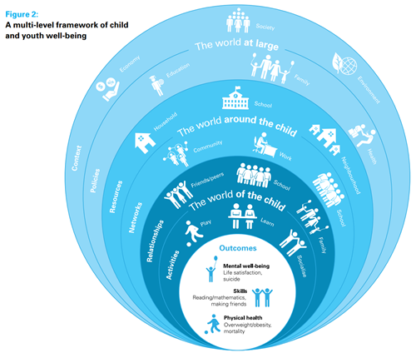
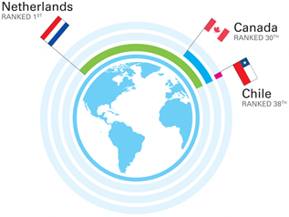
Social Medicine
Social Pediatrics
is about who we are not seeing and asking why... GC Robinson, MD, OC, UBC Dev & Social Pediatrics Founder
UNICEF Report Card 16: Child and Youth Well-being

