Slide 1


Open conversations in palliative care
An East Kootenay Project
Physician Lead: Greg Andreas
Project Lead: Shannon Girling-Hebert
Notes:
Kisa Qukit, Kisa Qatnam. I would like to acknowledge that it is an honor for both Greg and myself to live, work and play on the unceded territory of the Ktunaxa Nation. We are here today to share our project: Open Conversations in Palliative Care – the East Kootenay Experience

Slide 2
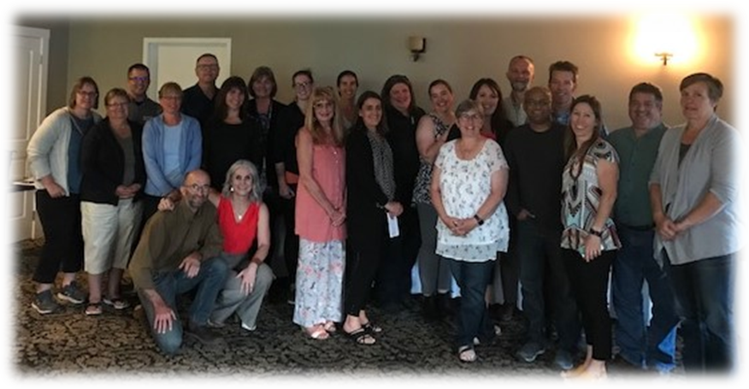
It takes a community to help someone to live their last chapter
Notes:
Our Project involves bringing together physicians and health and allied providers, along with family members, to collaborate and explore best practice and challenges associated with Palliative care with a goal to write the best last chapter of one’s life.

Slide 3
Meaningful Engagement with Patients and Caregivers

Slide 5
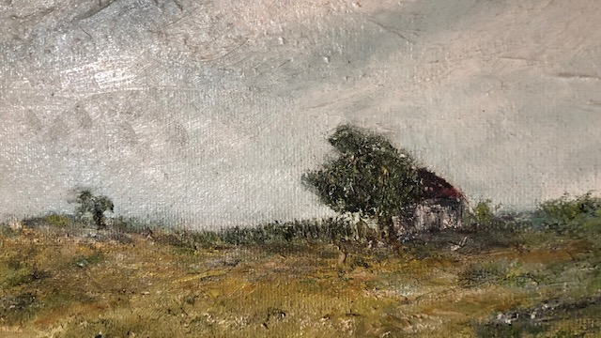

Slide 6


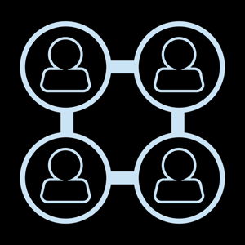
Role of story
Build relationship | Connection | Common goal across a diverse team

Slide 7

You

Slide 8


You
Me
We

Slide 9
You
Me
Best Possible Story
We

Slide 10
You
Me
Pathology =
Patient
We

Slide 11
Listening
Our Best Story
Curiosity
-Information
-Resources
-Rx
Empathy

Slide 12
The project
Seeks to meaningfully connect the people to make the best possible story to life’s final chapter:
  Explore personal values
  Find connection by story and conversation
  Encourage curiosity and self-awareness
  Hear personal stories about someone’s life journey
  Dynamic, cohesive, inclusive relationships within Integrated Collaborative Palliative Teams in each community
  Build capacity for providers to have difficult conversations
  Create Patient Journey Maps and a Team Collaborative Team Map as a communication tool
  Patient/Family Centered – Hopes – Fears - Worries
Notes:
As an integrated collaborative team we talk about values and connection. The project strives to promote curiosity and self-awareness. At each event attendees hear personal stories and from there talk about how relationships can be built to surround the patient with opportunities and services that best fit their individual needs. We also talk about difficult conversations and the value of truly getting to know the patient when initiating these conversations.

Slide 13
The who
Dinner meetings were held in four communities with local:
  Physicians
  Health Authority
  RN’s
  Care Aides
  Home Support
  Physiotherapists
  Hospice
  Aboriginal Health
  Patient Voice
  Case Managers
  Discharge Planners
  Human Service Workers
  Occupational Therapy
  Paramedics
  Social Workers
  Pharmacist
  Family Members
34 Physicians to date!
Notes:
We sat down together and shared a meal; like conversations around the kitchen table. We invited many interest groups and stakeholders. The biggest challenge was having to limit attendance. We needed groups in each community of 25 or less to have effective conversations. We had so much interest that a waitlist in each community needed to be kept. There was just that much interest in the project. A total of 34 physicians participated at four community events – at least 8 at each event. A Collaborative Team Map was developed showing what services are available from each entity/organization to support the palliative journey.

Slide 14
driving questions
As a professional, how do I connect with a person’s “end of life” story?
As a patient/family member, who will listen? Who can I trust?
Who else would help in writing the best possible final chapter?
How do we keep learning as individuals, as teams, as communities?
How do we interact to improve/enhance the experience for patients, their families, the physician and other members of the care team?
  What works well?
  What does not?
How do we ensure that “Listening” and “Curiosity” are recognized as key skills?
How do we foster ongoing connection and avoid unhappy story endings?
Notes:
The discussion evolved into break out sessions with a mixture of participants. For example, at one table there might be a physician, an RN, a Care Aid, Hospice, a First Nation nurse, a social worker, a community paramedic and a family member while another table would have a physiotherapist, an occupational therapist, a physician, an RN, a pharmacist, patient voice, case and discharge managers, etc. The driving questions were presented and all responses recorded and presented back to the larger group. This information was eventually collated and documented into a presentation format and sent out to all participants. A couple examples of how this changed or improved practice was Hospice’s commitment to provide awareness sessions on what they do and how they can help or how the community paramedic program can support home care and palliative patients at home.

Slide 15
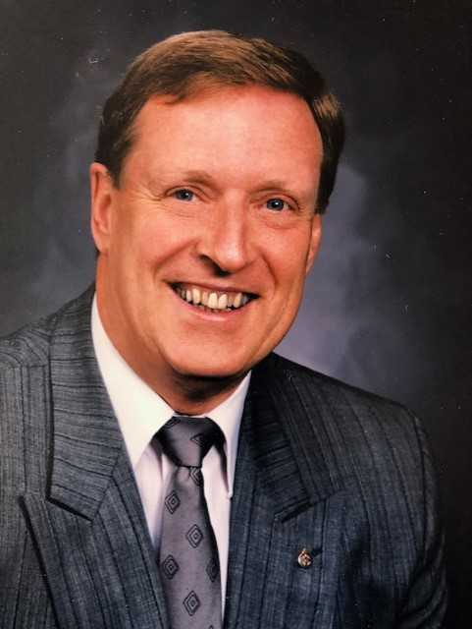
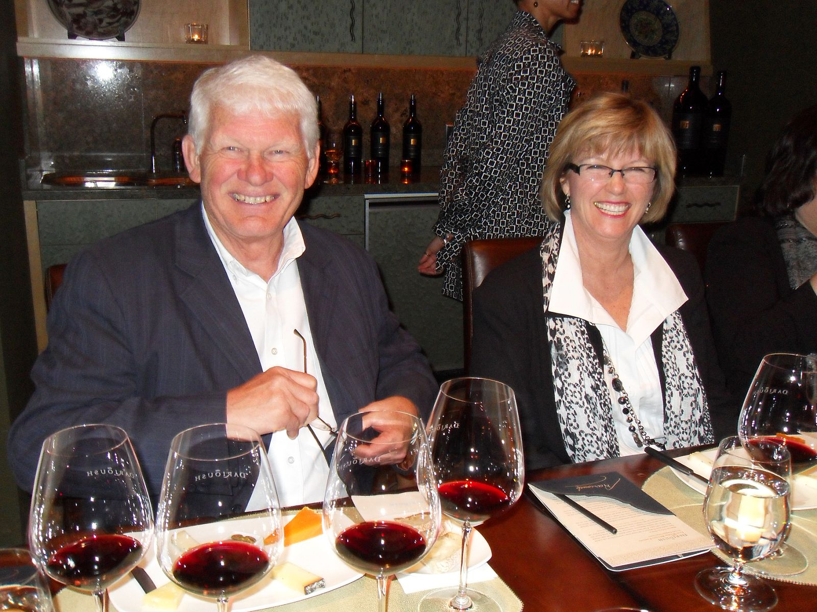
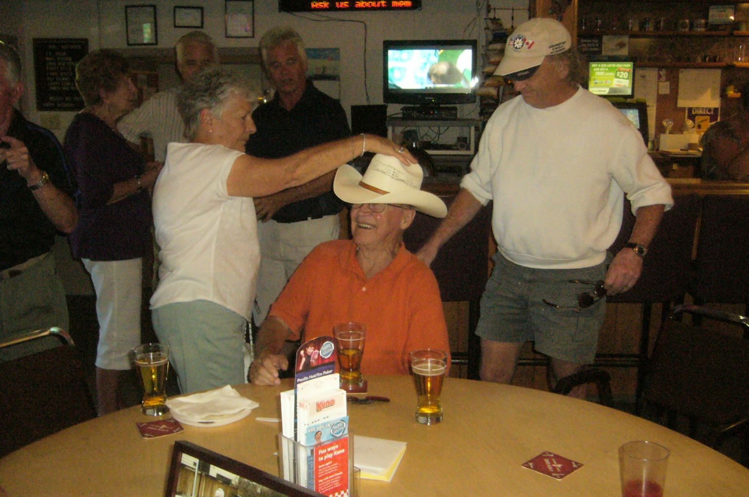
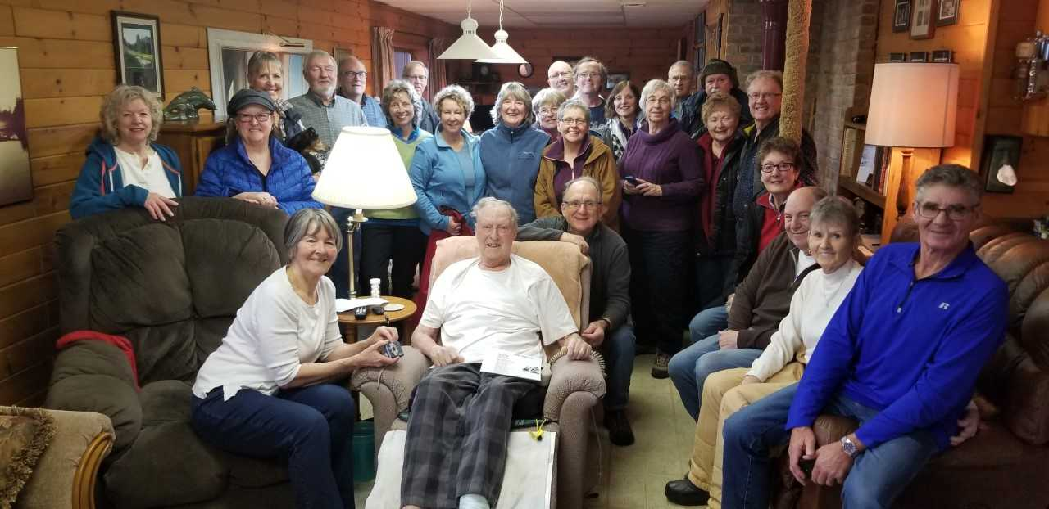
Getting to know patients and their families
Engaging Patients/Families
Their life; hopes; fears – where have they been
Notes:
Each Event is led by a local pilot physician who asks one of their patients or family member to tell the story of their personal Palliative journey;
Once identified, the patient or family member is contacted by the Project Lead to offer support, answer questions, and further explain the format and goals of the project;
The patient or family member writes their own story – it is not altered in any way;
The patient or family member attends the event and kicks off collaboration with the presentation of their story;
Following the patient or family member presentation, the attendees collaborate on best practices and challenges in Palliative Care – THEY DO NOT DEBATE the story – it belongs to the patient or family member and cannot be altered or disputed;
However, the patient or family member is a full participant in the collaborative content of the Event.

Slide 16
Patient journey maps
Dick’s Story
Ken’s Story
Rod’s Story
Notes:
The patient or family member subsequently works with the Project Lead in turning their story into a patient journey map – story board;
Again, the story is not changed; however, possible risk mitigations (where there were challenges) are added to the map;
The patient or family member is engaged throughout the mapping process;
The final draft of the Journey Map must be approved by the patient or family member before final printing.

Slide 17
Dicks Story
What mattered most to Dick was that he be in charge of the decisions for his end of life care; just as he had been in charge of the rest of his life.
Dick and his wife felt that the care team were very responsive and supportive to Dick’s end of life choice.
Notes:
Dick wanted to be at home and his wife wanted him home. This is a very personal decision. They were able to do everything on Dick’s time – eating, sleeping, watching TV – even visiting with neighbors and friends. It was most important for Dick to remain himself. Dick and Melody live in a rural location that does not have home support; however, they had a lot of support from the medical community. Dick felt in control of the end of his life just as he had for the rest of his life. Dick even went with his wife to the funeral home and planned his celebration of life. Melody felt that she and Dick grew even more close and more intimate at a deeper level than ever. Throughout Dick’s end of life care, Melody felt totally supported and grateful for the medical community and the many allied services provided to them.

Slide 18
KEN’S STORY
Ken’s family wanted his care team to know who he was – how he lived – where he had been – they wanted them to know that Ken was a father who lived life to the fullest.
Unfortunately, there wasn’t time – everyone was so busy. Even difficult conversations took place in less than desirable locations.
Sadly, the family, although appreciative of the tremendous care Ken received, felt the system failed them.
Notes:
Ken was a highly regarded hockey legend in the Kootenay Region. He was one of the game’s greats. Ken’s family struggled with Ken’s end of life care; mostly because they didn’t know it was the end of his life. Ken had struggled over the years with bouts of cancer but had always recovered. Unfortunately, those events, as well as other factors, contributed to poor heart health. There was no specific diagnosis for the family to understand why he was dying. Near the end, a physician described the situation in terms that the family could understand: “Your father has had many health challenges over the years, and those challenges have brought him to this point in his life. He is dying from all of those things. Not just one thing.” It was unfortunate that Palliative Care never started for Ken and, as a result, the family had no time to prepare. All of that said, and given the circumstances, Ken’s family felt that he had received tremendous care within the confines of the system.

Slide 19
Rod’s story
Rod, in his wife’s words, was truly the healthiest 82 year old around. There was nothing wrong with him – no medication, no high blood pressure, not diabetes – except he had cancer.
Rod had a difficult choice to make. With the support of his family and a collaborative compassionate team, a very difficult and personal decision was MaiD.
His wife, Dee, calls this picture Our Last Moment
Notes:
Rod was the founder of one of the most successful private schools in the Country. At the age of 75, Rod was diagnosed with prostate cancer. For the next seven years Rod fought a hard battle. Sadly, it was only two weeks before Rod’s death that Palliative Care was activated. However, Dee, Rod’s wife, felt that once the team sprung into action, much of her stress was taken off her shoulders. In the end, the pain was so intense that Rod and Dee asked about Medical Assistance in Dying. Rod wanted to be in control of his parting. They, however, did not have the time to wait out the process. Dee later said that with the grace and sheer professionalism, Rod’s medical team were able to speed up the process. Dee always thought Rod would go out kicking and screaming but that wasn’t the case. With the song Forever Young – Country Road playing, Rod’s medical team allowed him to go peacefully with his family at his side.

Slide 20
Adapting to the New Normal ? Covid-19
Team Zoom/telephone Meetings that include the patient/family
Distributing posters, brochures, newsletters and notices whether hard copy or electronically
New Patient Journey Map depicting a patient that has moved from Palliative Care to a healthy productive life
Sharing Patient Journey Maps with the Health Authority
Physician Zoom/telephone meetings seeking physicians’ perspective – stories
Circle back Zoom/telephone meetings with Physician Pilots in each community
Do you have any further ideas that support the change of culture we are looking for in living freely and life’s end?
Notes:
In early 2020 our project was significantly impacted by Covid-19. Because the Project was centered around gathering together, we had to step back and regroup. Pre-covid-19 we held in person events in four East Kootenay Communities and planned to hold events in Golden and the Elk Valley. The pandemic changed that knowing that gathering our most valuable health resources would be irresponsible given how much they are needed on the pandemic front. As a result, we have had to regroup and find new ways to maintain project momentum. During this time of social distancing, we are developing materials to be shared out to our providers and the health authority. One of which will be a Patient Journey Map about a patient, supported by an integrated collaborative team, that moved from Palliative to a healthy productive life. We hope to hold Physician web meetings hearing their stories and perspective on Integrated Palliative Care. We are also planning circle-back web meetings with our Physician Pilots in each of our communities to learn about the impact of this project on their Palliative practice as well as to hear about the growth of their integrated collaborative networks. What’s working well? What needs improvement? What is the next big idea?

Slide 21

Q and A

